Slide 1
Lecture 26
Logic BIST Architectures
Motivation
Built-in Logic Block Observer (BILBO)
Test / clock systems
Test / scan systems
Circular self-test path (CSTP) BIST
Circuit initialization
Loop-back hardware
Test point insertion
Summary

Slide 2
Motivation
Complex systems with multiple chips demand elaborate logic BIST architectures
  BILBO and test / clock system
    Shorter test length, more BIST hardware
  STUMPS & test / scan systems
    Longer test length, less BIST hardware
  Circular Self-Test Path
    Lowest hardware, lower fault coverage
Benefits: cheaper system test, Cost: more hdwe.
Must modify fully synthesized circuit for BIST to boost fault coverage
  Initialization, loop-back, test point hardware

Slide 3
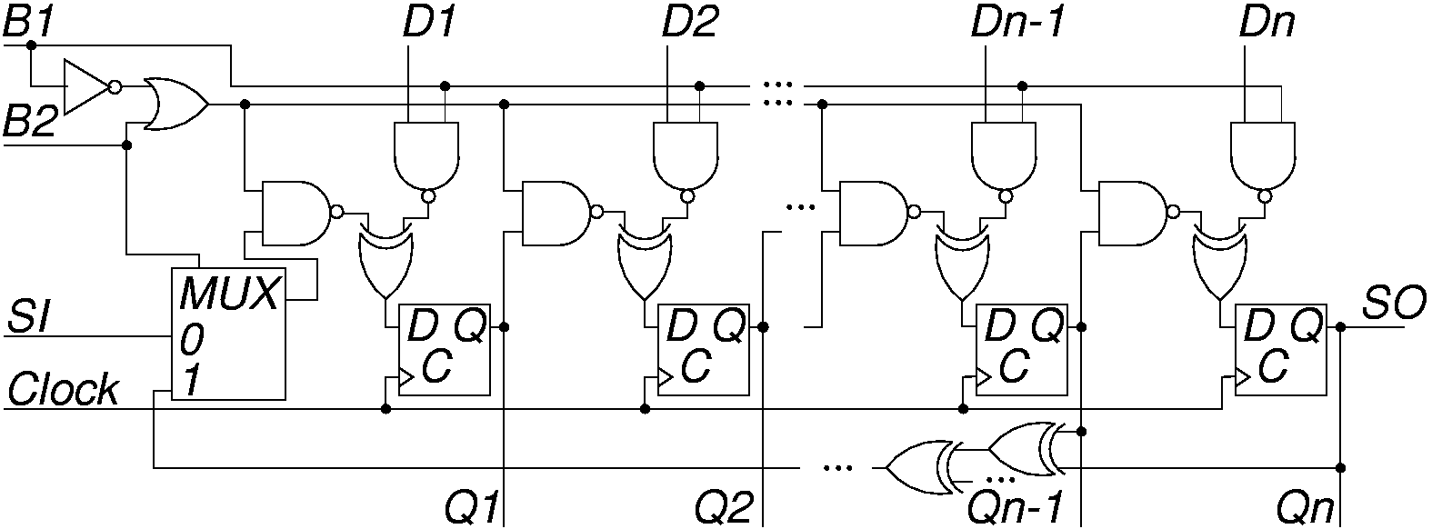
Built-in Logic Block Observer (BILBO)
Combined functionality of D flip-flop, pattern generator, response compacter, & scan chain
  Reset all FFs to 0 by scanning in zeros

Slide 4
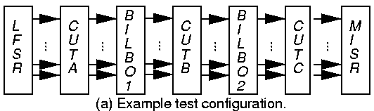
Example BILBO Usage
SI – Scan In
SO – Scan Out
Characteristic polynomial: 1 + x + … + x^{n}
CUTs A and C: BILBO1 is MISR, BILBO2 is LFSR
CUT B: BILBO1 is LFSR, BILBO2 is MISR

Slide 5
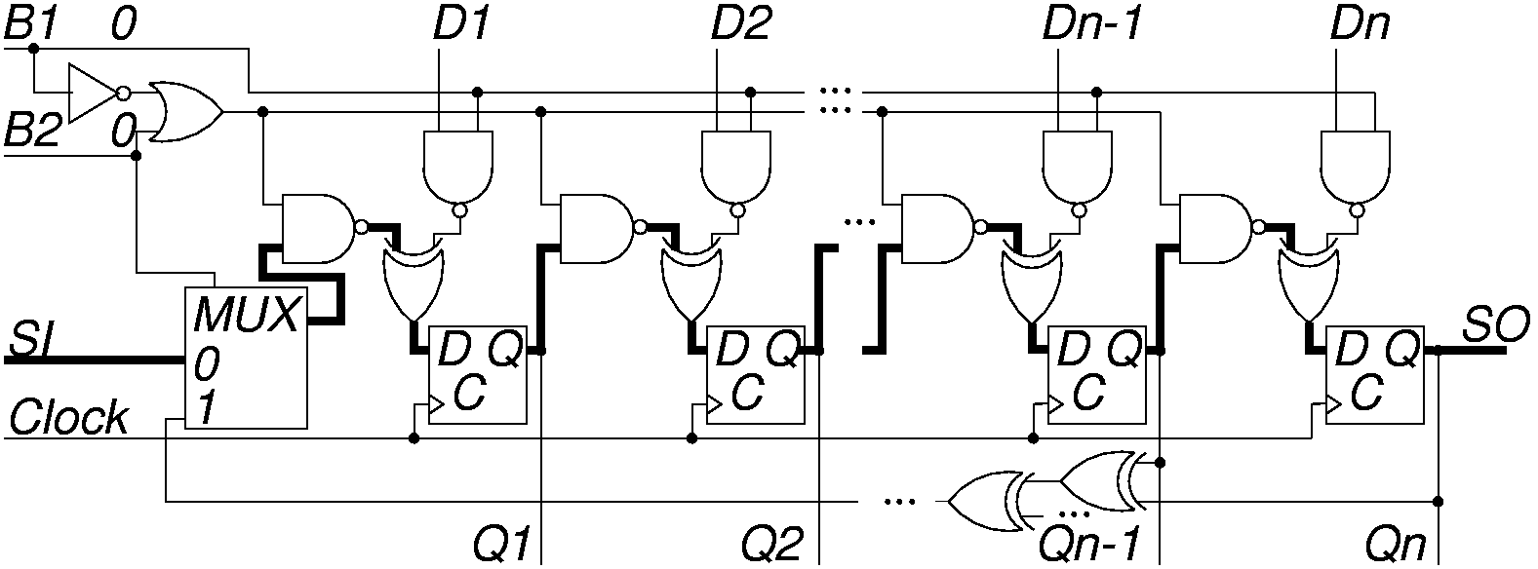
BILBO Serial Scan Mode
B1 B2 = “00”
Dark lines show enabled data paths

Slide 6
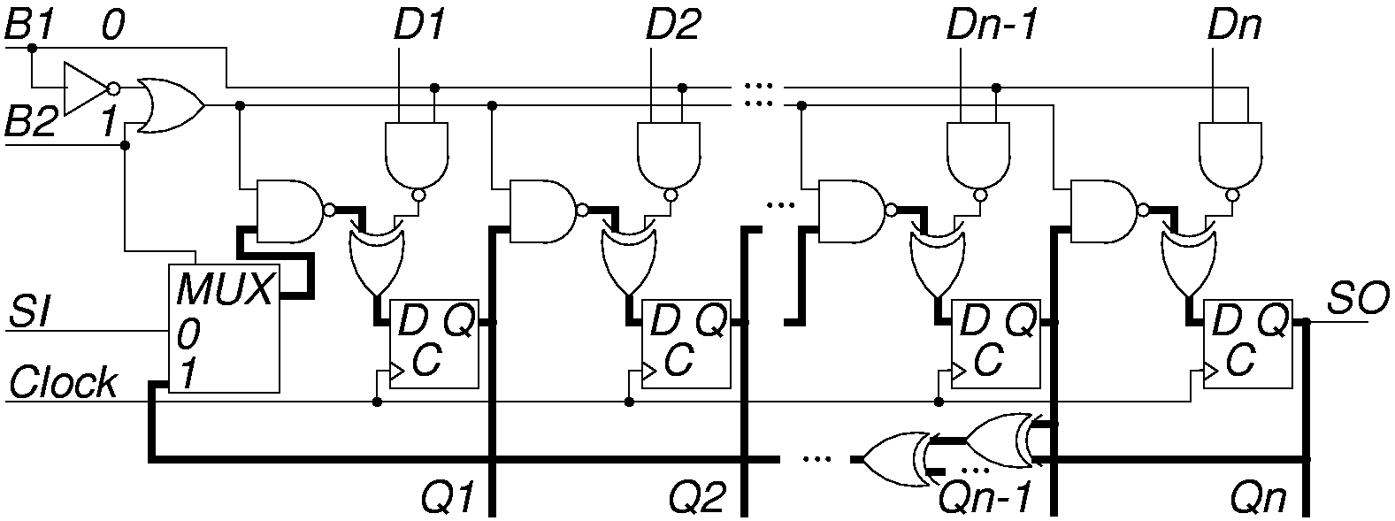
BILBO LFSR Pattern Generator Mode
B1 B2 = “01”

Slide 7
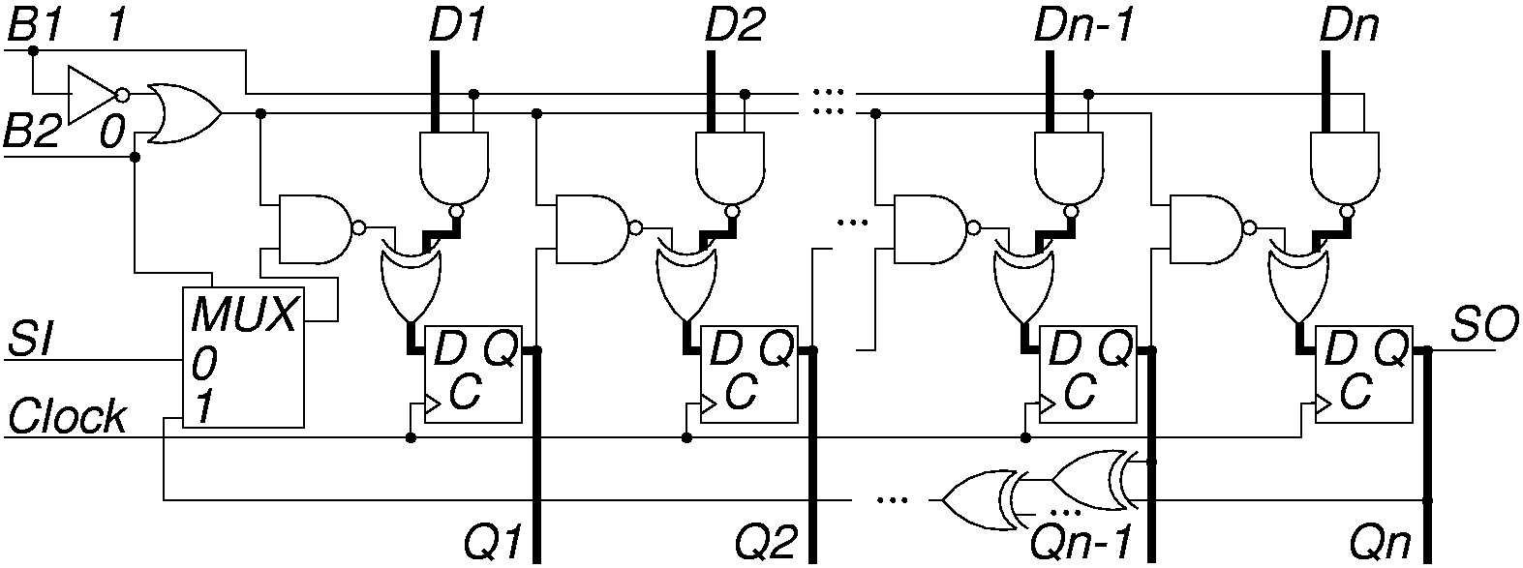
BILBO in D FF (Normal) Mode
B1 B2 = “10”

Slide 8
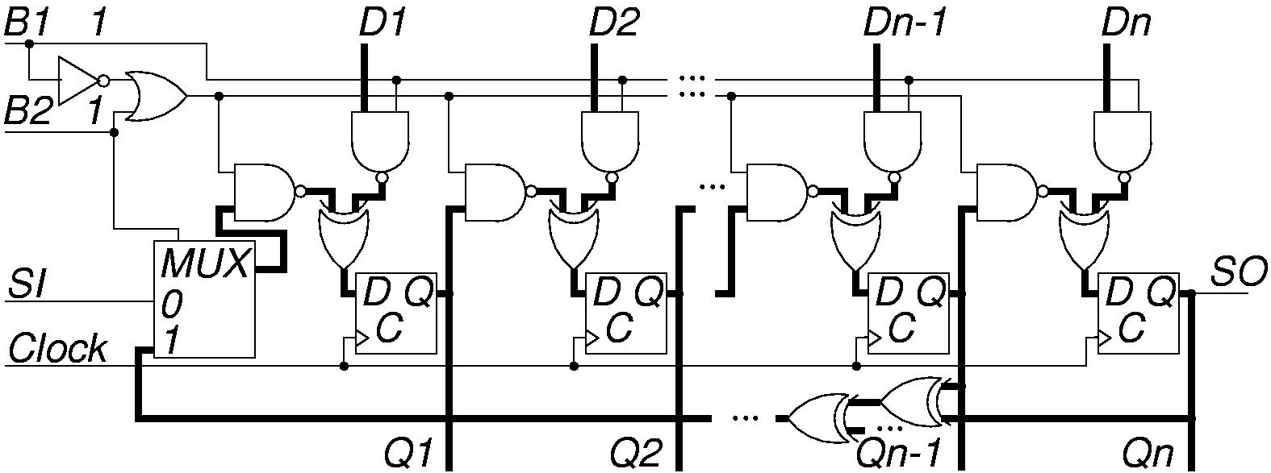
BILBO in MISR Mode
B1 B2 = “11”

Slide 9
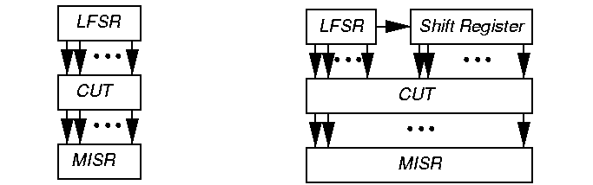
Test / Clock System Example
New fault set tested every clock period
Shortest possible pattern length
  10 million BIST vectors, 200 MHz test / clock
  Test Time = 10,000,000 / 200 x 10⁶ = 0.05 s
  Shorter fault simulation time than test / scan

Slide 10
Test / Scan System
New fault tested during 1 clock vector with a complete scan chain shift
Significantly more time required per test than test / clock
  Advantage: Judicious combination of scan chains and MISR reduces MISR bit width
  Disadvantage: Much longer test pattern set length, causes fault simulation problems
Input patterns – time shifted & repeated
  Become correlated – reduces fault detection effectiveness
  Use XOR network to phase shift & decorrelate

Slide 11
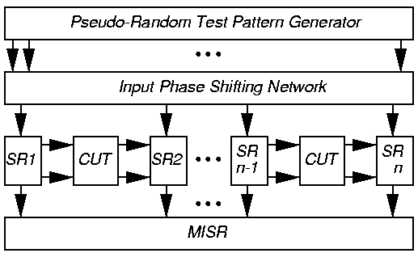
STUMPS Example
SR1 … SRn – 25 full-scan chains, each 200 bits
500 chip outputs, need 25 bit MISR (not 5000 bits)

Slide 12
STUMPS
Test procedure:
  Scan in patterns from LFSR into all scan chains (200 clocks)
  Switch to normal functional mode and clock 1 x with system clock
  Scan out chains into MISR (200 clocks) where test results are compacted
    Overlap Steps 1 & 3
Requirements:
  Every system input is driven by a scan chain
  Every system output is caught in a scan chain or drives another chip being sampled

Slide 13
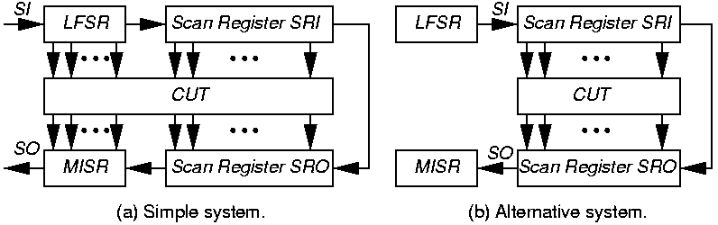
Alternative Test / Scan Systems

Slide 14
BILBO vs. STUMPS vs. ATE
LSSD: Level-sensitive scan design
ATE rate: 325 MHz
P = # patterns
CP = clock period = 10⁻⁹ s
  Self-test speed
  LSSD tester speed
Test times – BILBO: P x CP STUMPS: P x L x CP
  ATE: P x L x CP x k
  External test & ATE: 307 x longer than BILBO
  STUMPS: 100 x longer than BILBO
    Due to extra scan chain shifting
System clock rate: 1 GHz
L = max. scan chain length
k = = 3.07692

Slide 15
Circular Self-Test Path (CSTP) BIST
Combine pattern generator and response compacter into a single device
Use synthesized hardware flip-flops configured as a circular shift register
  Non-linear mathematical BIST system
  Superposition does not hold
  Flip-flop self-test cell – XOR’s D with Q state from previous FF in CSTP chain
MISR characteristic polynomial: f (x) = x^{n} + 1
Hard to compute fault coverage

Slide 16
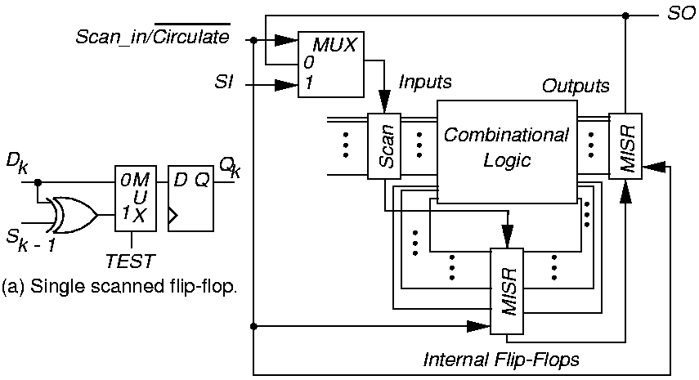
CSTP System

Slide 17
Examples of CSTP Systems
CSTP BIST for 4 ASICs at Lucent Technologies:
  Tested everything on 3 of the 4, except for:
    Input/Output buffers and Input MUX
BIST overheads: logic – 20 %, chip area – 13 %
Stuck-at fault coverage – 92 %

Slide 18
Circuit Initialization
Full-scan BIST – shift in scan chain seed before starting BIST
Partial-scan BIST – critical to initialize all FFs before BIST starts
  Otherwise we clock X’s into MISR and signature is not unique and not repeatable
Discover initialization problems by:
  Modeling all BIST hardware
  Setting all FFs to X’s
  Running logic simulation of CUT with BIST hardware

Slide 19
Circuit Initialization (continued)
If MISR finishes with BIST cycle with X’s in signature, Design-for-Testability initialization hardware must be added
Add MS (master set) or MR (master reset) lines on flip-flops and excite them before BIST starts
Otherwise:
  Break all cycles of FF’s
  Apply a partial BIST synchronizing sequence to initialize all FF’s
  Turn on the MISR to compact the response

Slide 20
Isolation from System Inputs
Must isolate BIST circuits and CUT from normal system inputs during test:
  Input MUX
  Blocking gates –
    AND gate – apply 0 to 2nd AND input, block normal system input
Note: Neither all of the Input MUX nor the blocking gate hardware can be tested by BIST
  Must test externally or with Boundary Scan (covered later)

Slide 21
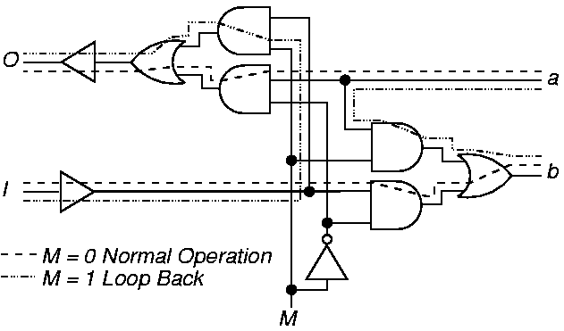
Loop-Back Circuit
Loop back outputs into inputs:

Slide 22
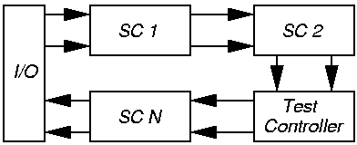
System Test with Loop-Back
Exercise entire system with loop-back circuit
Use Boundary Scan to test chip interconnects

Slide 23
Test Point Insertion
BIST does not detect all faults:
  Test patterns not rich enough to test all faults
Modify circuit after synthesis to improve signal controllability
Observability addition – Route internal signal to extra FF in MISR or XOR into existing FF in MISR

Slide 24
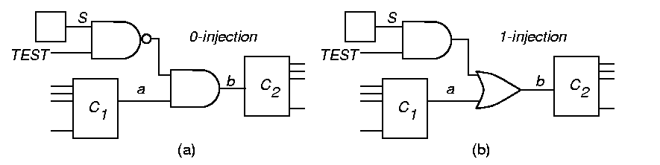
0 and 1 Injection
Force b to 0 when TEST & S are 1
Force b to 1 when TEST & S are 1

Slide 25
Test Point Activation
Four test epochs Φ₀, Φ₁, Φ₂, Φ₃
Phase decoder: enables different parts at different phases
Apply specified test pattern count at each
Example:
  g_{t} = 0 in Φ₁ & Φ₂, so c₁ = 0
  g_{t} = 1 in Φ₀ & Φ₃, so c₁ = g
  h_{t} = 1 in Φ₂ & Φ₃, so c₂ = 1
  h_{t} = 0 in Φ₀ & Φ₁, so c₂ = h

Slide 26
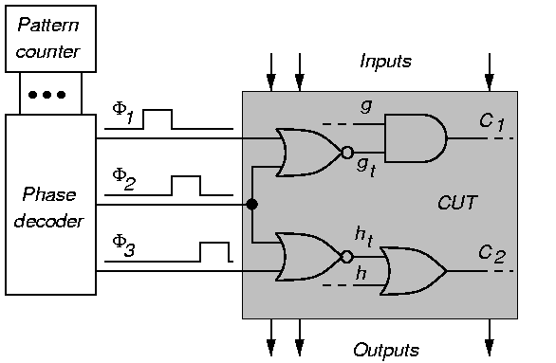
Test Point Activator

Slide 27
Summary
Logic BIST system architecture --
  Advantages:
    Higher fault coverage
    At-speed test
    Less system test, field test & diagnosis cost
  Disadvantage: Higher hardware cost
Architectures: BILBO, test / clock, test / scan
Needs DFT for initialization, loop-back, and test points

